Slide 1
LLM-FOMC Ideation

Slide 2
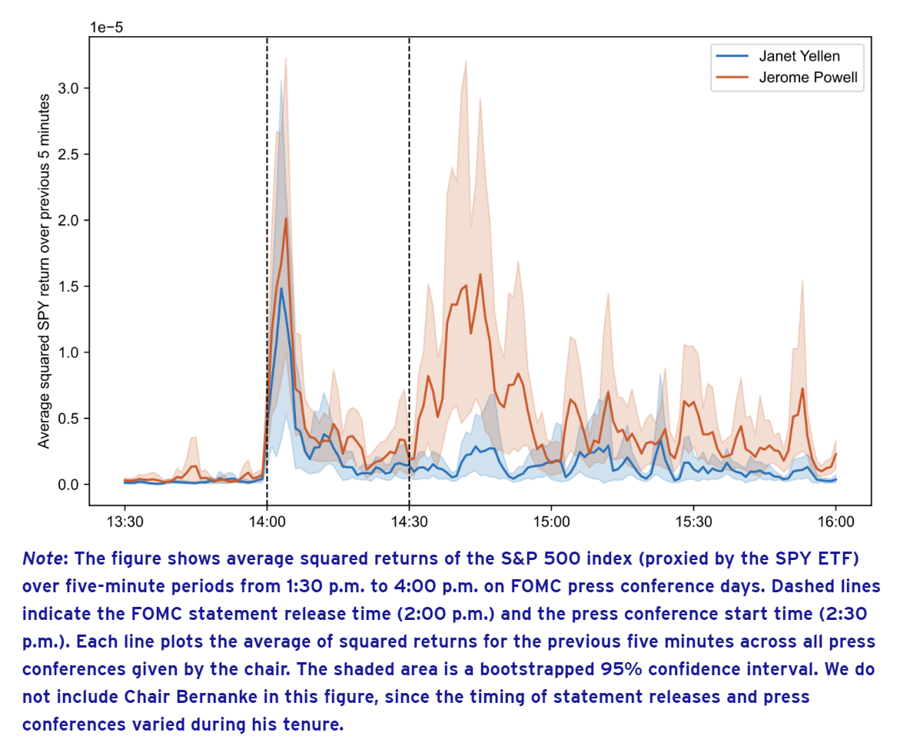
FOMC statement and Pres Conf effects on market volatility in S&P 500
Observations:
Volatility increases with statements (2pm) and press conference (2:30pm)
Each chairman has different effect on this volatility

Slide 3
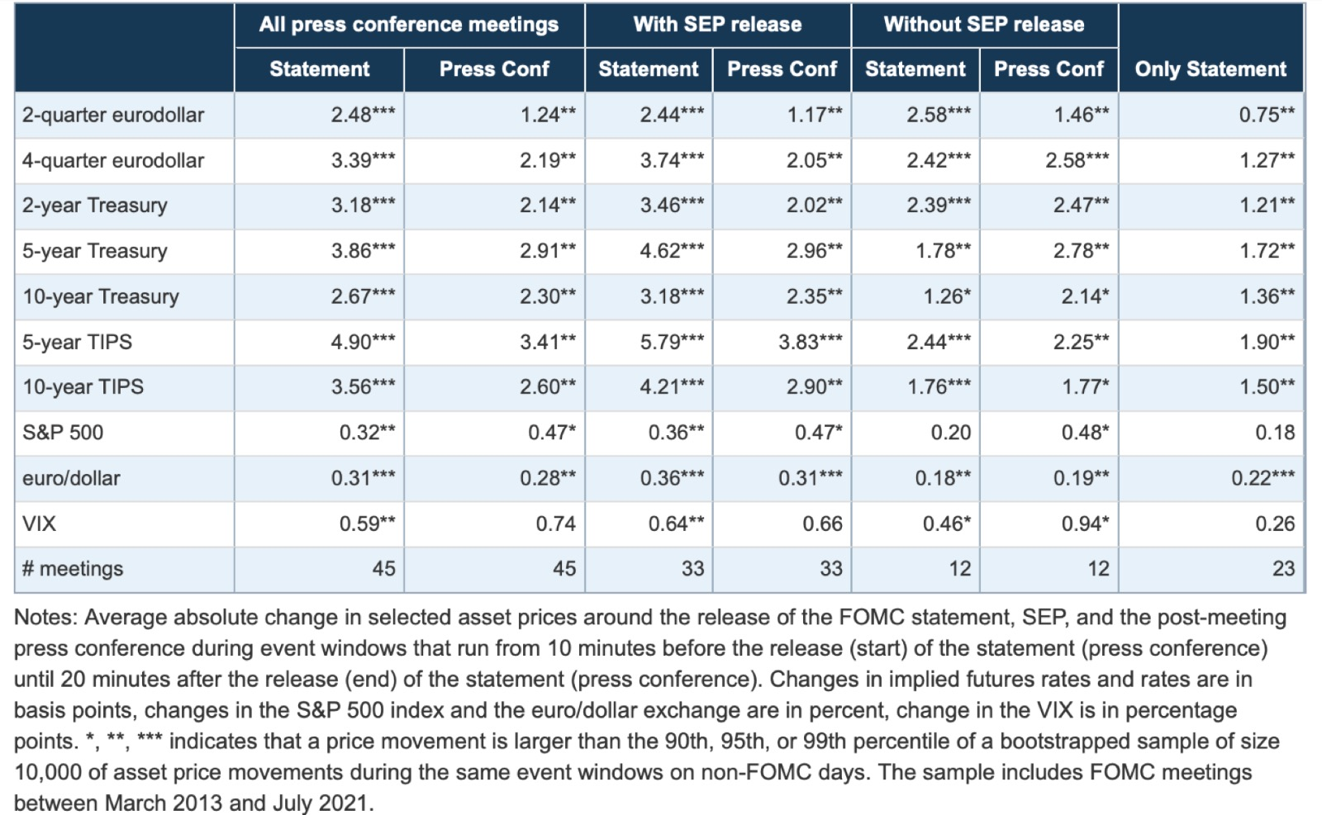
Correlation to other asset prices…

Slide 4
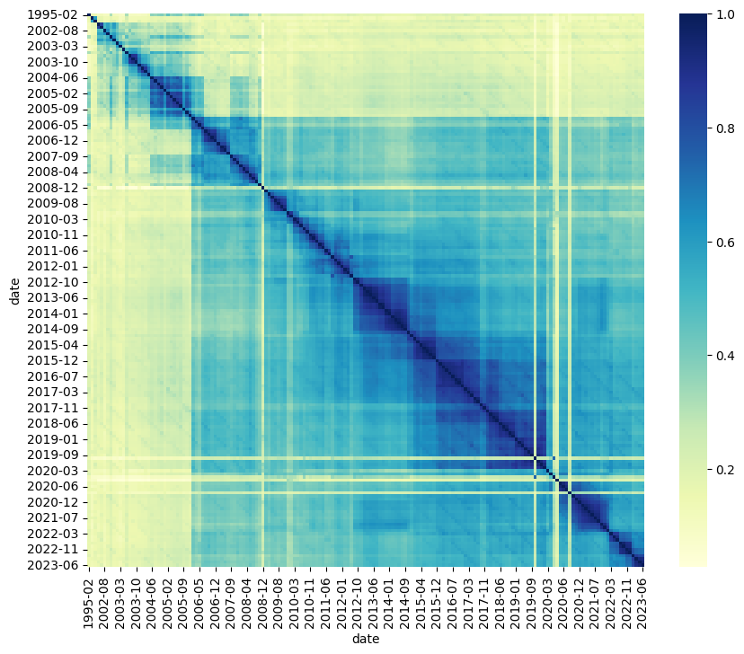
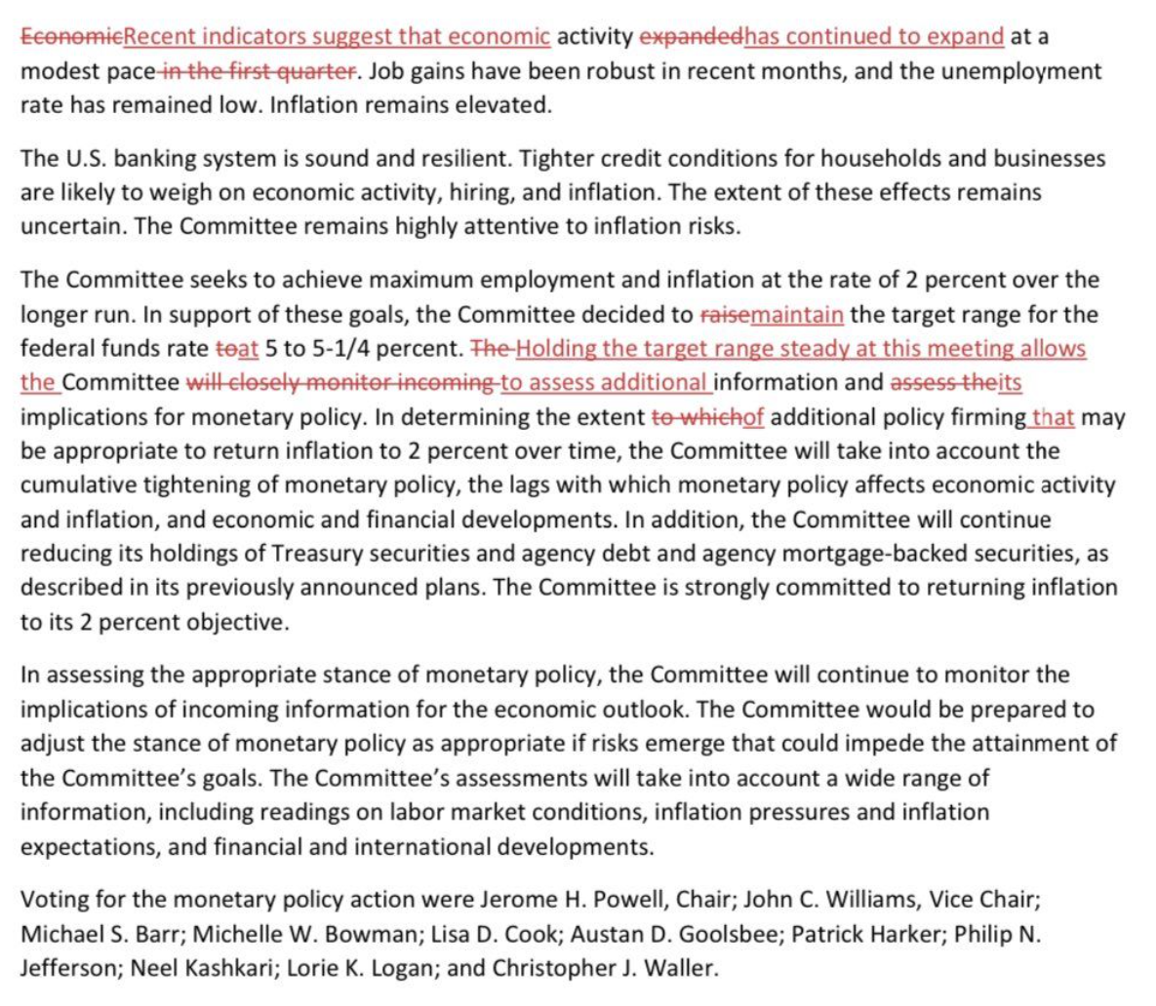
2:00 pm EST: Cosine similarity in FOMC statements
Snippet FOMC June 2023 vs Apr 2023:
Inference:
The document has monetary decisions and related changes (numerical)
And the hawkish/dovish signal
For ex. raise -> maintain -> lower ( hawkish -> neutral -> dovish)

Slide 5
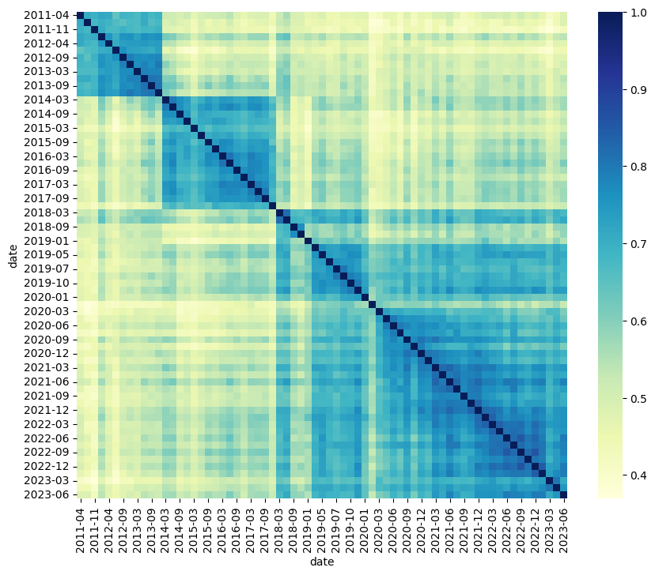
2:30pm EST: Cosine similarity in Press Conf transcripts
Bernanke
Inference:
Each chairman has a different tone
For each chairman, the dissimilarity of words (tone) is causing the amplitude of volatility
Yellen
Powell

Slide 6
Breaking down Press conf:
Opening remarks (~10min):
Economic situation (GDP, unemployment, demand & supply, interest rates, inflation etc) (and their respective realised values)
Projections of these macro-economic indicators and goals (expected values)
Hawkish/dovish signal for each indicator (Tone in speech)
Question/Answer pattern (~30min):
How are you combating {inflation/unemployment/etc.} despite ______ ?
Expected co-movements of macro indicators given ____ ?
Has your expectation for {indicator} changed since ____ ?
Since 1994, there are 69 press conferences with 25 questions each at an average. So we have approximately for Powell : 1000 Q/A pairs, Yelen : 400 Q/A pairs and Bernanke: 300 Q/A pairs.

Slide 7
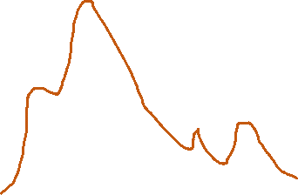
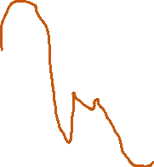
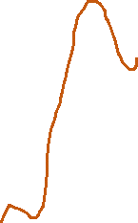
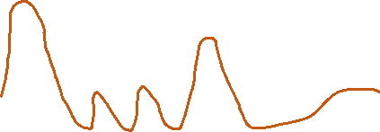
Timeline of model steps:
Average return over every 5 min
H₂
H₁
H₁
H₂
Volume of trades every 5 min
14:00
14:30
15:15
Model 1
Model 2

Slide 8
14:00
14:30
Model 1
Model 2
TRAINING DATA (original FOMC statements)
Macro-economic indicators
+
Future expectations (dot plot)
+
Hawkish/Dovish signal
(tone)
=
(target)
H₁
INFERENCING
(crafted/original FOMC statements)
Realised Macro-economic indicators
+
Future expectations (from public opinion)
+
{masked/realised}
Hawkish/Dovish signal
(tone)
Scenarios of these reports can give me a confidence interval for H₁

Slide 9
14:00
14:30
Model 1
Model 2
TRAINING DATA
Original FOMC statements
+
Press conference transcripts
Opening statements (indicators, expectations, and tone)
+
Q/A
=
(target)
H₂
INFERENCING
Crafted/original FOMC statements
+
Press conference transcripts
{masked tone}
Opening statements (indicators, expectations, and tone)
+
{masked answers}
Q/A
Scenarios of these reports can give me a confidence interval for H₂

Slide 10
Appendix

Slide 11
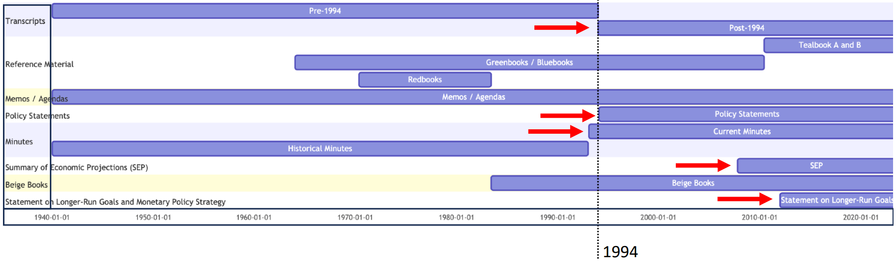
Data timeline

Slide 12
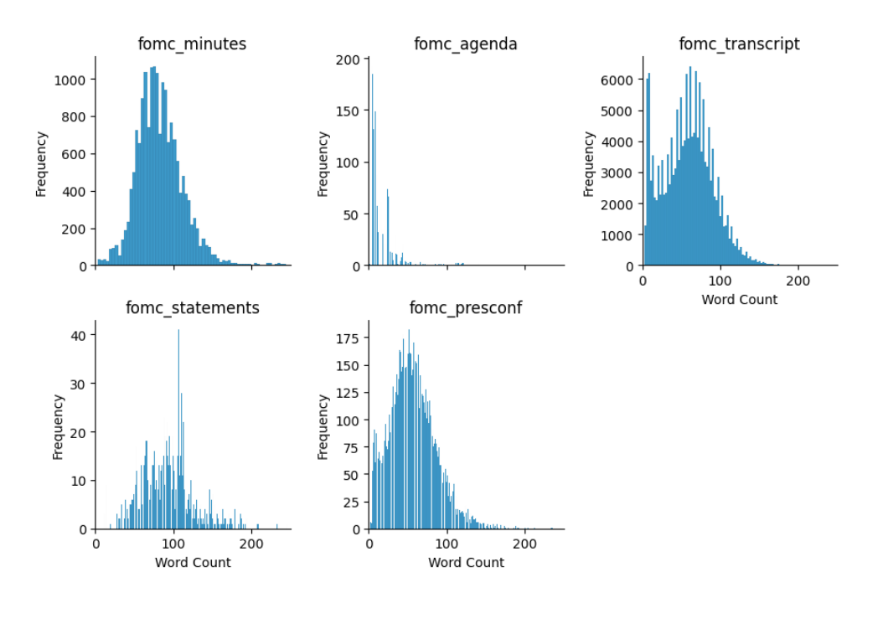
Data downloaded (1994-2023)
Agenda – 190 docs
Transcripts – 190 docs
Minute – 227 docs
Statements – 176 docs
Press Conference – 69 docs

Slide 13
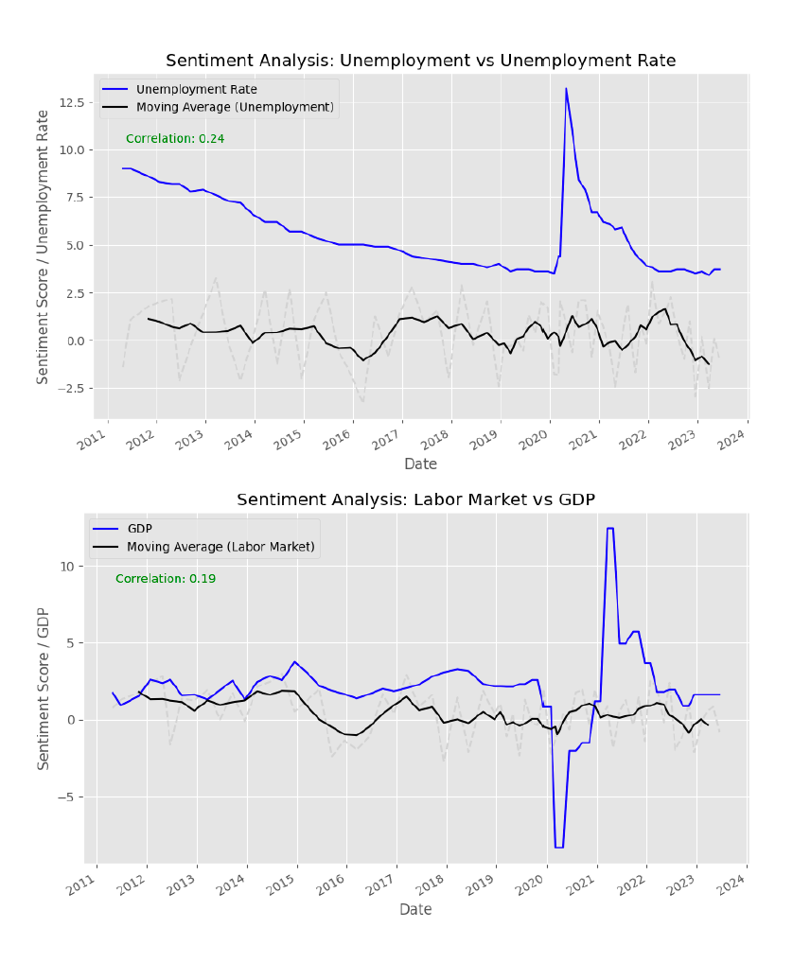
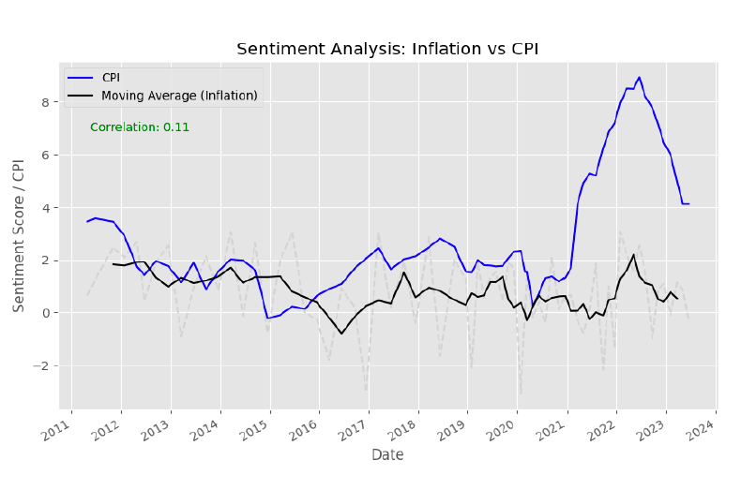
Sentiment analysis – (crudely)

Slide 14
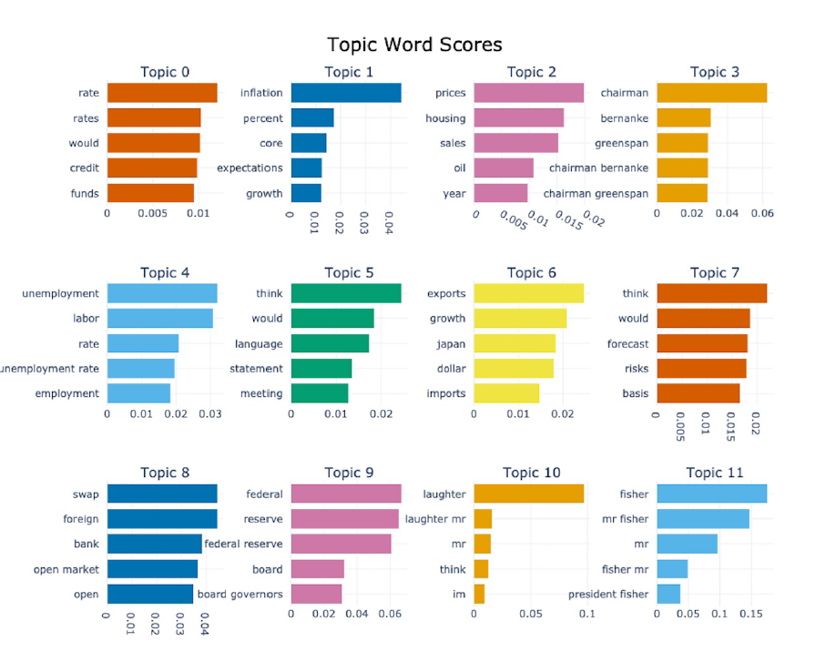
BERTopic modelling

Slide 15
